Slide 1
Containers and Kubernetes a Testers Perspective
Jan 2025

Slide 2
Agenda
What is a container
What is Kubernetes & Helm
Applying this to the pipe-line

Slide 3
Introduction to containers
What are Containers
Lightweight, portable units of software
Package application code, dependencies and configurations together
Ensures consistency across environments (development testing and production)
Key features
Isolation: Each container runs independently
Portability: Runs anywhere – local machine cloud or hybrid setups
Efficiency: Shares the host OS kernel reducing overhead
Tools: Docker, Podman and containerd

Slide 4




Explaining containers
Imagine your going on a trip
Pack your suitcase
Travel to location
Suitcase contains everything you need

Slide 5
Why Use Containers
Works the same on all machines (“No more it works on my machine”)
Lightweight by sharing the Kernel
Containers don’t have a full OS, They only include specific tools, libraries and dependencies
They borrow resources form the OS of the machine they are on
As docker containers that run on a host machine share the hosts OS kernel (host is Linux based or uses compatibility layer like WSL2)

Slide 6
VM’s vs Docker
Key Differences
VM’s: Resource intensive, slow boot times
Containers: Lightweight, share host OS, fast start times
Feature | Virtual Machine | Container
Size | GBs | MBs
Startup Time | Minutes | Seconds
Isolation Level | Full OS | Process-Level

Slide 7
Introduction to Kubernetes
Where did Kubernetes come from
Kubernetes was created by Google to manage its cloud infrastructure
What is Kubernetes
An open-source container orchestration platform
Automates the deployment, scaling and management of containerised applications
Kubernetes terminology
Pod – smallest deployable unit (one or more containers)
Node – Machine (Physical or Virtual)
Cluster – Group of Machines

Slide 8
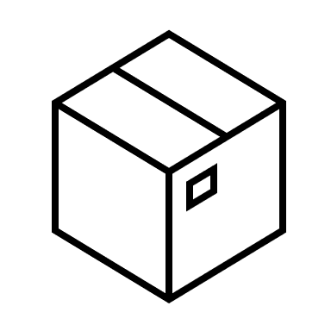
Helm
Helm is an open-source tool that helps manage the deployment of applications in a Kubernetes cluster
Helm charts make use of templating and is written in YAML
Each of the environments will use a common template
dev
test
prod

Slide 9
Helm Chart file structure
Helm-chart
|- Chart.yml
|- values.yml
|- templates/
| |- deployment.yaml
| |- services.yaml
| |- configmap.yaml
|- charts/

Slide 10
YAML
YAML is a markup language and it’s a mark up language
Industry standard used in various applications such as:
Ansible – administration tool for deploy applications to Unix boxes
Azure DevOps
Jenkins

Slide 11
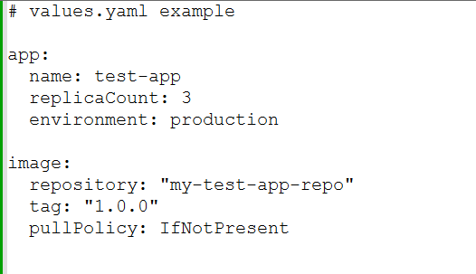
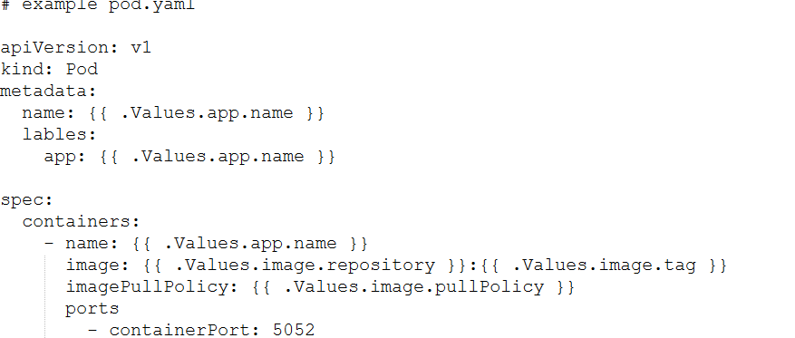
YAML example

Slide 12
Pipeline
Create containing our applications
This container may also pull all our scripts into it.
Create a helm script to deploy our containers to servers
Modify the CI/CD pipeline
This could involves adding a test stage
Update your pipeline for updating and displaying the results

Slide 13
Pipeline
Example pipeline triggered when code submitted to base branch
Build Apps
Run Unit Tests
Deploy Apps to test Env
Run Tests
Generate results

Slide 14
Summary
During talk we Covered Containers
Kubernetes
How we can use these in testing
Q&A

